Slide 1
Part 2: AC Circuits
Sinusoids and Phasors
Sinusoidal Steady-State Analysis
AC Power Analysis
Three-Phase Circuits

Slide 2
Chapter 11 AC Power Analysis
Introduction
Instantaneous and average power
Maximum average power transfer
Effective or rms value

Slide 3
Chapter 11 AC Power Analysis
Apparent power and power factor
Complex power
Conservation of ac power
Power factor correction

Slide 4
Chapter objectives
Know the difference between instantaneous power and average power
Learn the AC version of maximum power transfer theorem
Learn about the concepts of effective or rms value
Learn about the complex power, apparent power and power factor
Understand the principle of conservation of AC power
Learn about power factor correction

Slide 5
Key points
Definitions of instantaneous power, average power, complex power, and apparent power
Sinusoidal steady-state power calculation
Maximum average power transfer

Slide 6
Difficult points
Understand the definitions of these powers
Understand the concept of power factor and the method of power factor correction
Understand the condition of maximum average power transfer

Slide 7
11.1 Introduction
Our major concern in this chapter is power analysis;
Power analysis is of paramount importance;
every industrial and household electrical device has a power rating that indicates how much power the equipment requires;
The choice of ac over dc allowed high-voltage power transmission from the power generating plant to the consumer.

Slide 8
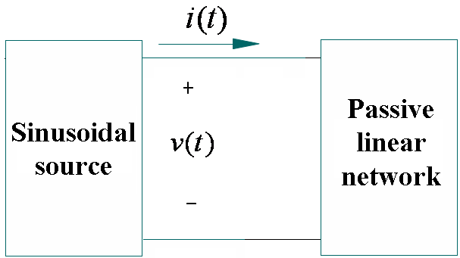
11.2 Instantaneous and average power
The instantaneous power p (t):

Slide 9
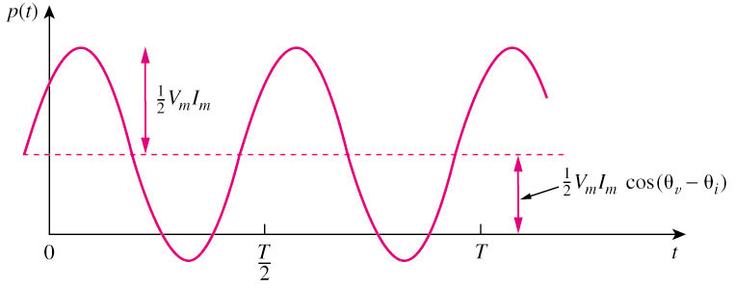
The instantaneous power, p(t)
Constant power
Sinusoidal power at 2ω
p(t) > 0: power is absorbed by the circuit; p(t) < 0: power is absorbed by the source.

Slide 10

Average Power
The average power, P, is the average of the instantaneous power over one period, measured in watts (w).
P is not time dependent.
When θ_{v} = θ_{i} , it is a purely resistive load case.
When θ_{v}– θ_{i} = ±90º, it is a purely reactive load case.
P = 0 means that the circuit absorbs no average power.

Slide 11
average power
Average Power absorbed by R,L,C:
When
Voltage and current are in phase
When
We have a purely reactive circuit

Slide 12
In Summary:
A resistive load (R) absorbs power at all times, while a reactive load (L or C ) absorbs zero average power.
P ：Average power, Real Power, or Active Power; Watts (W)
+
+
R
_
+
jX_{L}
_
+
_
-jX_{C}
_

Slide 13
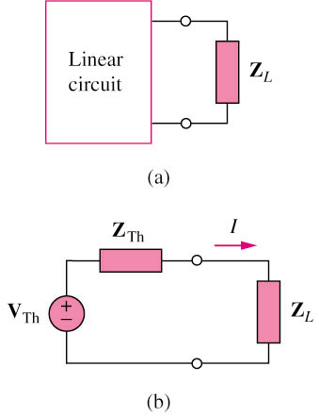
11.3 Maximum Average Power Transfer
The current through the load is

Slide 14
The average power delivered to the load is :

Slide 15
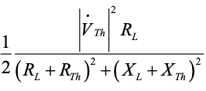
P=
∂ P/ ∂ X_{L}=0
∂ P/ ∂ R_{L}=0

Slide 17
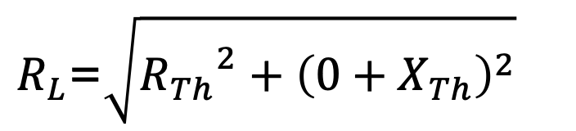

When the load is purely real, the condition for maximum power transfer is obtained from Eq. (2) by setting X_{L} = 0; that is,
(2)
$R_{L}$=$\sqrt{{R_{Th}}^{2}+{\left(0+X_{Th}\right)}^{2}}$
$$=\left|Z_{Th}\right|$$

Slide 18
Example
For the circuit shown, what value of Z_{L} results in maximum average power transferred to Z_{L}? What is the maximum average power?

Slide 19
Solution:
The Thevenin equivalent with respect to the two terminals of the load is:

Slide 20
Hence, can result in maximum average power transferred to Z_{L}. The maximum power is:

Slide 21
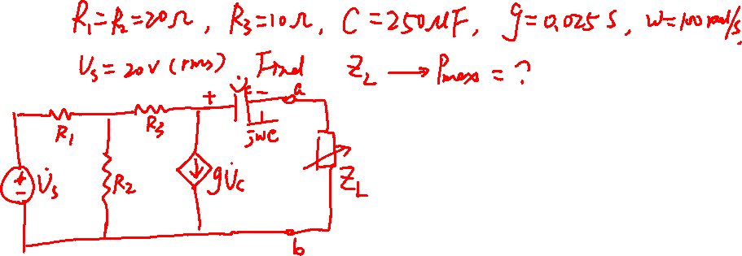

Slide 22
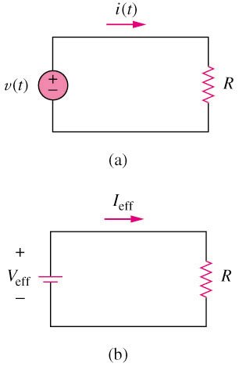
11.4 Effective or rms value
The effective value of a periodic current is the dc current that delivers the same average power to a resistor as the periodic current.
The average power dissipated by R is given by:
Hence, I_{eff} is equal to:
The effective value of a periodic signal is its root mean square (rms) value.

Slide 23
The rms value of a sinusoid:
Similarly
Note: It is convenient in power analysis to express voltage and current in their rms values. Also, analog voltmeters and ammeters are designed to read directly the rms value of voltage and current, respectively.

Slide 24
Average power:
The average power absorbed by a resistor R:

Slide 25

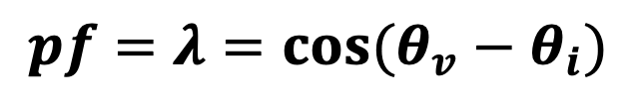

11.5 Apparent power and power factor
Power Factor, pf
Apparent Power, S
Apparent Power S
$$S=V_{rms}I_{rms}$$
(volt-amperes or VA )
Power factor ( pf )
$$pf=λ=\cos{(θ_{v}−θ_{i})}$$
（dimensionless）
Power factor angle $θ$

Slide 26
Purely resistive load (R) | θ_{v}– θ_{i} = 0, pf = 1 | P=S
Purely reactive load (L or C) | θ_{v}– θ_{i} = ±90º, pf = 0 | P = 0
Resistive and reactive load (R and L/C) | θ_{v}– θ_{i} > 0 θ_{v}– θ_{i} < 0 | Lagging - inductive load Leading - capacitive load
Leading power factor means that current leads voltage, which implies a capacitive load. Lagging power factor means that current lags voltage implying an inductive load.

Slide 27


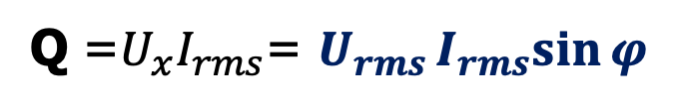

Reactive power Q
+
+
R
_
+
×
$$I_{rms}$$
jX_{L}
S
_
Q
+
θ
_
-jX_{C}
_
P
$$P=U_{R}I_{rms}=U_{rms}I_{rms}cos{φ}$$
(W)
Q =$U_{x}I_{rms}$= $U_{rms}I_{rms}sin{φ}$
(VAR)
$$=\left(U_{L}−U_{C}\right)I_{rms}$$

Slide 28
Active powers and reactive powers of R, L and C
P=U_{rms}I_{rms}cosϕ
Q=U_{rms}I_{rms}sinϕ
Active powers and reactive powers of R , L and C
element | φ | P(w) | Q(var) | pf
resistor | 0 | U I >0 | 0 | 1
capacitor | -90⁰ | 0 | -U I < 0 | leading
inductor | 90⁰ | 0 | U I > 0 | lagging
Resistors only absorb active power, the reactive power Q=0
Capacitors supply reactive power, inductors absorb reactive power.
They are complementary in reactive power.
Capacitors and inductors do not dissipate active power, but exchange power back and forth with the source.

Slide 29
11.6 Complex power
where
= P + j Q

Slide 30


P (real power): is the average power delivered to a load and it is the only useful power.
P depends on the load’s resistance R.
Q(reactive power): is a measure of the energy exchange between the source and the reactive part of the load.
Q depends on the load’s reactance X.
$$=I_{rms}^{2}R$$
(W)
$$=I_{rms}^{2}X$$
(VAR)
Q = 0 for resistive loads (unity pf).
Q < 0 for capacitive loads (leading pf).
Q > 0 for inductive loads (lagging pf).

Slide 31
Complex power (in VA) is the product of the rms voltage phasor and the complex conjugate of the rms current phasor. As a complex quantity, its real part is real power P and its imaginary part is reactive power Q.
Complex Power

Slide 32
Complex Power:
Apparent Power:
Real Power:
Reactive Power:
Power Factor:

Slide 33
Power Triangle

Slide 34
Power triangle
×
×
|Z|
S
X
Q
θ
θ
R
P
Impedance Triangle
Power Triangle

Slide 35
θ
θ
Power Factor

Slide 36
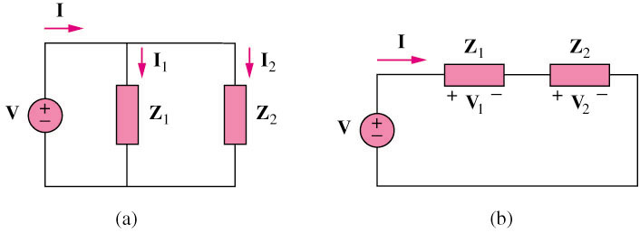
11.7 Conservation of AC Power
(a) Impedances and are connected in parallel across an ac source V.
(b) If the loads are connected in series with the voltage source,

Slide 37
Whether the loads are connected in series or in parallel (or in general), the total complex power supplied by the source equals the total complex power delivered to the load. Thus ,
The total complex power in a network is the sum of the complex powers of the individual components. (This is also true of real power and reactive power, but not true of apparent power.)
The complex, real, and reactive powers of the sources equal the respective sums of the complex, real, and reactive powers of the individual loads.

Slide 38
Why ?
S< S₁+S ₂
Q =Q ₁ +Q ₂
P=P₁ +P₂

Slide 39
Example Find the total real power, reactive power and apparent power in the circuit.
39.6
A
= 1.36
− 75.7
= 0.86
I₂
A
I
+
I₁
1.90
80
A
=
R₁
R₂
40 Ω
0
20 Ω
U = 220
− jX_{C}
− j114 Ω
jX_{L}
j157 Ω
−
[Solution] Method 1
Find the total powers by using the voltage and current at the terminals
P = U I cosϕ = 220×0.86×cos ( 0 − 39.6 ) W = 146 W
Q = U I sin ϕ = 220×0.86×sin ( 0 − 39.6 ) var = − 121 var
S = U I = 220×0.86 V·A = 190 V·A
39
返 回
上一节
下一节
上一页
下一页

Slide 40
Find the total powers by using the branch powers
Method 2
P = P₁ + P₂ = U₁ I₁ cosϕ ₁+ U₂ I₂ cosϕ ₂
=｛220 × 1.9 × cos ( 0 − 80 ) +
220 × 1.36 × cos [0 − ( − 75.7 )]｝W
= (72 + 74) W
= 146 W
Q = Q₁ + Q₂ = P₁ tanϕ₁ + P₂ tan ϕ₂
= ( − 411 + 290) var
= − 121 var
S =√P² + Q²
= 190 V·A
40
返 回
上一节
下一节
上一页
下一页

Slide 41
Find the total powers by using the powers of the individual elements
Method 3
P = R₁I₁² + R₂I₂² = ( 20×1.9² + 40×1.36² ) W = 146 W
Q = − X_{C} I₁² + X_{L}I₂² = ( − 114×1.9² + 157×1.36² )
= − 121 var
S =√P² + Q²
= 190 V·A
41
返 回
上一节
下一节
上一页
下一页

Slide 42
Example
Δ
In the ac circuit, the frequency ω= 100 rad/s, the readings of the voltmeter and ammeter are 50 V and 1 A respectively. The wattmeter reads 30 W.
(1) Find the values of R and L;
(2) Determine the reactive power of the inductor.
A
W
*
+
R
V
Z
_
L
Solution:
L=0.4 H

Slide 43
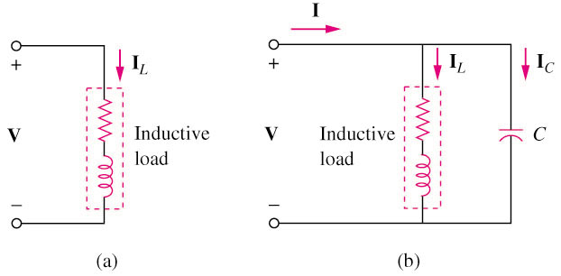
11.8 Power Factor Correction
Power factor correction is the process of increasing the power factor without altering the voltage or current to the original load.
Power factor correction is necessary for economic reason.

Slide 44

How to calculate the capacitance in parallel?
+
-
$$=jwC$$

Slide 45
Increasing the power factor
0
φ
φ₁
+
_

Slide 46
Conclusion (power factor correction):
I
The total current
the total power factor
，
，
the total apparent power S
The working conditions of the load remain unchanged.
The power factor of the load cosφ₁ is not changed.
The current through the load is not changed.
The total real power of the circuit is not changed.

Slide 47
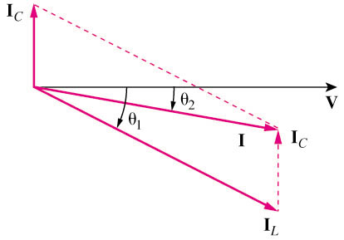
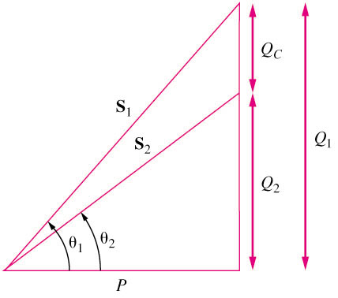
Q_{c} = Q₁ – Q₂
= P (tan θ₁ - tan θ₂)
= ωCV²_{rms}
Q₁ = S₁ sin θ₁
= P tan θ₁
P = S₁ cos θ₁
Q₂ = P tan θ₂

Slide 48
Example: f=50HZ，U=380V，cosφ1=0.6，P=20KW，find the value of capacitance necessary to raise the pf to 0.9.
Solution：
0
φ
φ₁

Slide 49
The value of the required shunt capacitance C is determined as

